Slide 1
Healthcare Provider Webinar
Middlesex and London Region
June 20, 2023

Slide 2
Welcome
Presenter:
Dr. Alex Summers
Medical Officer of Health
Middlesex-London Health Unit
@alexsummers4

Slide 3
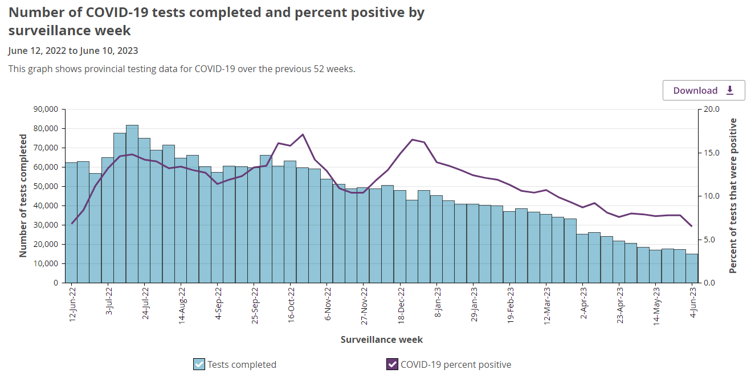
Data source: Public Health Ontario- Ontario COVID-19 Data Tool, extracted 2023-06-20. Data current as of the end of day 2023-06-10. https://www.publichealthontario.ca/en/Data-and-Analysis/Infectious-Disease/COVID-19-Data-Surveillance/COVID-19-Data-Tool?tab=overview

Slide 4
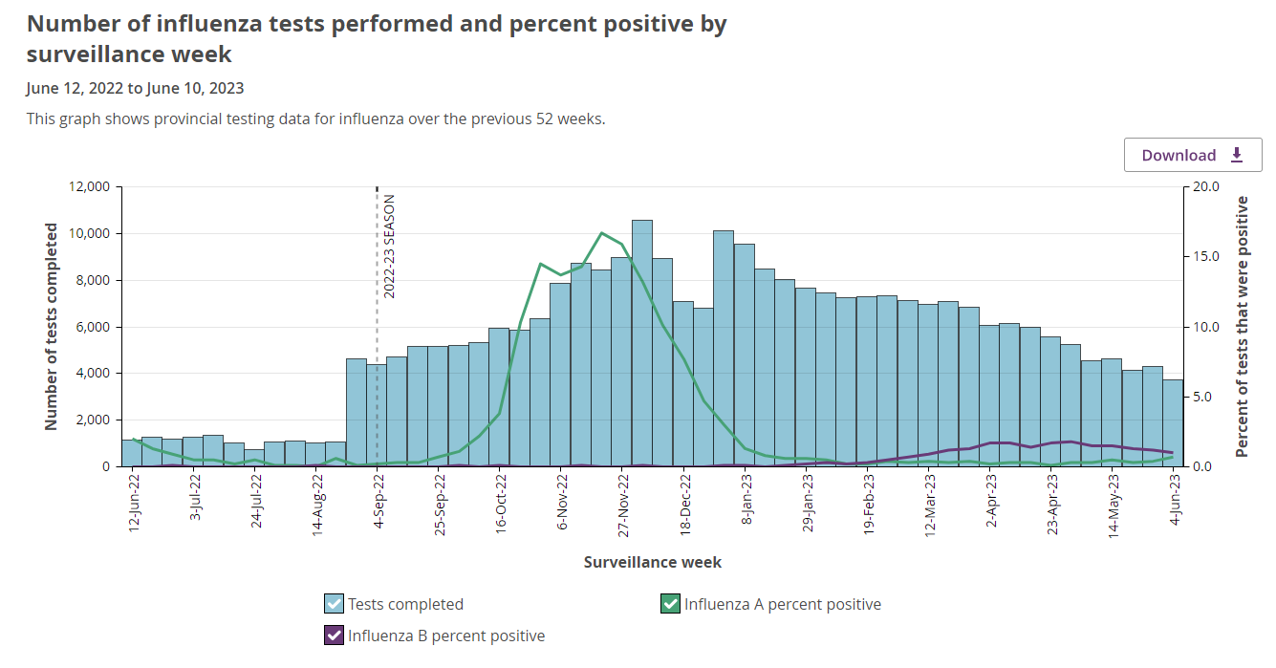
Data source: Public Health Ontario- Ontario COVID-19 Data Tool, extracted 2023-06-20. Data current as of the end of day 2023-06-10. https://www.publichealthontario.ca/en/Data-and-Analysis/Infectious-Disease/COVID-19-Data-Surveillance/COVID-19-Data-Tool?tab=overview

Slide 5
Changes to the MLHU Tuberculosis (TB) Immigration Medical Surveillance Program
There has been a significant increase in the number of individuals being referred from Immigration, Refugees, and Citizenship Canada (IRCC) for TB Immigration Medical Surveillance (IMS) assessments in the Middlesex-London region throughout the past few years.
To meet this demand, effective June 30, 2023, the Health Unit will be referring assessments for low-risk TB IMS clients to community providers.

Slide 6
Should a client present to your office or clinic with a letter indicating they require an assessment to rule out active TB:
Send client for a chest x-ray (PA and lateral)
Once the x-ray report is received, complete the TB Immigration Medical Surveillance Physician Report, located on the HCP Forms webpage
For more information, please see Tuberculosis (TB) for Healthcare Providers.
The Health Unit’s TB Clinic will continue to provide assessments for high-risk TB IMS clients, as well as support for community providers who wish a second opinion.

Slide 7
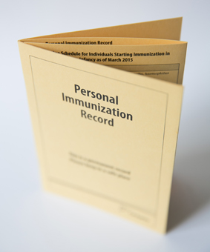
Vaccine Preventable Disease Team – Special Presentation
Immunization record assessment and administration errors
Agenda:
-Importance of correct assessment / impact of errors
-Common errors and contributing factors
What are the most common errors?
How do we avoid these errors?
What to do when an error occurs?
-Tools and supports for HCPs
Notes:
Good afternoon everyone, my name is Stephanie McKee and I am a Public Health Nurse with the Vaccine Preventable Disease Team.
I’m sure those of you in the audience who work in primary care are familiar with the Health Unit’s immunization screening letters. Throughout the year, the Vaccine Preventable Disease Team assesses or “screens” immunization records for school age students and mails letters to households with children who are missing vaccines. These students then follow-up with their primary care provider if they have one to receive the vaccines or get a record of previous vaccines to update the Health Unit.
I want to take a minute thank healthcare providers for making vaccines a priority and helping to promote and administer them in our community. Determining what vaccines child needs can be difficult and increasingly so lately for several different factors.
This leads us to our topic of discussion. Today I will be covering immunization record assessment and administration errors, specifically:
The importance of correctly assessing immunization records and the impacts of errors
Common errors
What they are
How to avoid them
What to do if they occur
Tools available to assess records
Supports that the Health Unit offers to support HCPs

Slide 8
Importance of Correct Assessment
Record assessments guide decisions on vaccine administration, including which vaccines a patient needs and when they are needed
Vaccine administration errors resulting from incorrect assessment may lead to:
Inadequate immunological protection
Failure to meet childcare and school requirements
Repeat or additional vaccines – inconvenience and increased costs
Reduced patient confidence
Common Errors | Contributing Factors
Incorrect combination vaccine administered – right antigens but wrong strength. | Vaccines with the same or similar antigens may have differing dose strengths.
Vaccine administered at an unauthorized age. | Vaccines have different authorized ages.
Notes:
Importance of Correct Immunization Record Assessment
Record assessments guide decisions on vaccine administration, including what vaccines a patient needs and when they are needed
Vaccine administration errors resulting from incorrect assessment may lead to:
Inadequate immunological protection
Failure to meet school legislation requirements
Repeat or additional vaccines – inconvenience and increased costs
Reduced patient confidence
We are going to look at some of the common errors that the VPD team sees as we are screening or assessing immunization records. These are errors that our colleagues at other health units are seeing as well. What I want our focus to be during this presentation, however, is not on the errors themselves but on recognizing the factors that often contribute to them and tips for making the correct assessment.
Listed as the first common error is…
Common error #1 – Incorrect combination vaccine administered. You’ve selected a vaccine that may include all or most of the antigens that the patient needs, but the concentration of protection in that vaccine is less than what the patient requires.
The factor that contributes to this is having combination vaccines with the same or similar antigens, but they have different strengths of protection.
The concentration or “strength” of protection a patient requires to illicit an adequate immune response may depend on the patient’s age and immunization history.
This is relevant with the tetanus-containing vaccines, which we will review in detail shortly
Common error #2: Vaccine product administered at an unauthorize age.
The factor that contributes to this is having similar vaccine products may have different authorized ages for administration.
Even though you may be administering a vaccine with all the antigens a patient needs, it may not be authorized or licensed for use based on that patient’s age. This is relevant with the MMRV vaccine, which isn’t authorized for use in patients age 13 years and older even if they need protection against all 4 of those antigens. Again, we will review this more shortly.

Slide 9
Common Errors | Contributing Factors
Vaccines administered too early | The authorized use of a vaccine may be at an age that is earlier than childcare and school requirements. Administering the vaccine even a couple days early may result in the child being incompliant.
Vaccines administered too close together | Spacing requirements between vaccines varies and depends on the vaccine type and the patient’s vaccine history.
Incorrect assessment of catch-up schedules | Deviations from routine vaccine schedules have become more common. These records necessitate a greater understanding of catch-up schedules.
Notes:
Common error #3: Vaccines administered too early to count to count for childcare and school legislation.
Contributing factor – The authorized use of a vaccine may be at an age that is earlier than childcare and school requirements. Administering the vaccine even a couple days early may result in the child be incompliant.
The immunization schedule is set based on ages when a child is most at risk and maturity of the immune system. Giving the vaccine early may mean child does not develop the full immune response and during the time when they need to be protected the most.
This is particularly tricky when parents may book appointments a few days earlier than when a vaccine is due. It is always better to give the vaccine a few days after the due date or appropriate spacing than before.
Common error #4: Vaccines administered too close together.
Contributing factor – Spacing requirements between vaccines varies depending on what vaccine we are administering and the patient’s vaccine history.
Spacing between doses of the same vaccine in a primary series is different depending on whether you’re administering the second third, or in some cases fourth dose. It becomes tricker when a patient requirements multiple live vaccines – when they are not administered on the same day, specific spacing is required so the second live vaccine doesn’t interfere with the immune response of the first. Again - It is always better to give the vaccine a few days after the due date or appropriate spacing than before.
The last common error we have listed is…
Common error #5: Incorrect assessment of catch-up schedules
Contributing factor – Deviations from routine vaccine schedules have become more common because we have newcomers from countries and even just from other provinces that are following different vaccine schedules and because we had service interruptions during COVID when patients missed vaccines.
If you’ve ever tried to read the catch-up schedules on the Publicly Funded Immunization Schedules for Ontario document, you know how confusing and complicating they can be.

Slide 10
Tetanus-Containing Combination Vaccines
Antigen Code | Products Available | Antigen protection included in vaccine
DTaP-IPV-Hib | Pediacel | diphtheria (D), tetanus (T), acellular pertussis (aP), polio (IPV), and haemophilus influenzae type b (Hib)
Tdap-IPV | Adacel-Polio | tetanus (T), diphtheria (d), acellular pertussis (ap), and polio (IPV)
Tdap | Adacel | tetanus (T), diphtheria(d), and acellular pertussis (ap)
True or False?: Tdap-IPV (Adacel-Polio) is always the appropriate tetanus-containing vaccine to administer to a child between 4 and 6 years old.
Answer: X FALSE
Notes:
We are going to look a little closer at some of these contributing factors as they relate to some specific vaccines. Let’s start with Tetanus-containing vaccines.
There are 4 tetanus containing vaccines. We will only be looking at three of them here – the 4th is combination tetanus-diphtheria vaccine which is only given later in adulthood:
DTaP-IPV-Hib – Pediacel - diphtheria (D), tetanus (T), acellular pertussis (aP), polio (IPV), and haemophilus influenzae type b (Hib)
Tdap-IPV – Adacel-Polio - tetanus (T), diphtheria (d), acellular pertussis (ap), and polio (IPV) (excludes hib)
Tdap – Adacel – tetanus (T), diphtheria (d), acellular pertussis (ap) (excludes hib and polio)
I want you all to take a minute to think about your response to this question.
True or False – Tdap-IPV (Adacel-Polio) is always the appropriate tetanus-containing vaccine to administer to a patient between the ages of 4 and 6 years old.
Answer is False! While Tdap-IPV would be the correct vaccine to administer for a child following routine schedule, it would be considered “invalid” or not meet legislative requirements and result in inadequate protection in a child who is missing some or all of their doses due at 2, 4, 6 and 18 months old.

Slide 11
The case of the antigen code (capital or lower-case letter) indicates the strength of the dose.
DTaP-IPV-Hib (Pediacel) = HIGH DOSE DIPHTHERIA & PERTUSSIS
Tdap-IPV (Adacel-Polio) = low dose diphtheria & pertussis
Rule #1: if child is 6 wks to < 4 y.o., DTaP-IPV-Hib is the ONLY OPTION. Invalid doses in this age group include: Doses administered before 6 weeks old or before minimum spacing Tdap-IPV administered instead of DTaP-IPV-Hib Invalid doses should be repeated following at appropriate spacing
RULE #2: if child is between 4 and 6 y.o. and has received at least 3 previous doses of DTaP-IPV-Hib appropriately spaced, administer Tdap-IPV. If patient has received 0-2 valid doses, administer DTaP-IPV-Hib.
RULE #3: if patient is between 7 and 17y.o., Tdap-IPV or Tdap are used, depending on the number of valid doses of polio the patient has received.
Notes:
So what’s the difference between these vaccines besides the obvious difference of the antigens they cover?
The case of the antigen code (capital or lower-case letter) indicates the strength of protection
DTaP-IPV-Hib contains greater strength protection against diphtheria and pertussis than Tdap-IPV and Tdap (D and aP vs. d and ap)
All tetanus containing vaccines contain the same strength of protection against tetanus. DTaP-IPV-Hib and Tdap-IPV also contain the same strength of protection against polio.
DTaP-IPV-Hib = HIGH DOSE DIPHTHERIA & PERTUSSIS vs Tdap-IPV / Tdap = low dose diphtheria & pertussis
When assessing records for tetanus vaccine, there are a few rules I would like you to be mindful of:
Rule #1: if your patient is 6 weeks to less than 4 years old, DTaP-IPV-Hib (pediacel) is your only option
Why? Because patients of this age need a greater concentrations of diphtheria and pertussis to build up their immunity than older children and children who have already been vaccinated
We use the term invalid when we refer to doses that don’t count towards childcare and school requirements along with recommendations and authorized uses.
The first dose of DTaP-IPV-Hib is due when an infant is 2 months old. If the first dose is early, the infant needs to be at least 6 weeks old for the dose to be considered valid
If a dose is administered too close the dose before it, it is also considered invalid
Any doses of Tdap-IPV (Adacel-Polio) administered instead of DTaP-IPV-Hib (Pediacel) are also considered invalid.
Invalid doses should be repeated following appropriate spacing
Rule #2: if your patient is between 4 and 6 years old and has received at least 3 previous doses of DTaP-IPV-Hib appropriate spaced, administered Tdap-IPV but if your patient has received 0-2 valid doses, administer DTaP-IPV-Hib.
Why? Children who have receive 2 or less doses of DTaP-IPV-Hib have not yet received enough prior protection against diphtheria and pertussis and still need that high strength dose
You’ll notice this does allow a bit of wiggle room – if children are following the routine schedule, they would have received 4 doses of DTaP-IPV-Hib. However so long as they have received 3 valid doses, we can proceed with the 4-6 year dose and this will complete their primary series
Rule #3: If patient is between 7 and 17 years old, Tdap-IPV or Tdap are used depending on the number of valid doses of polio the
Why? By this age, a lower concentration of diphtheria and pertussis are needed to illicit the necessary immune response
For school requirements, a minimum of 3 doses of polio are needed with one dose over the age of 4 years old and the last dose 6 months from the previous dose

Slide 12
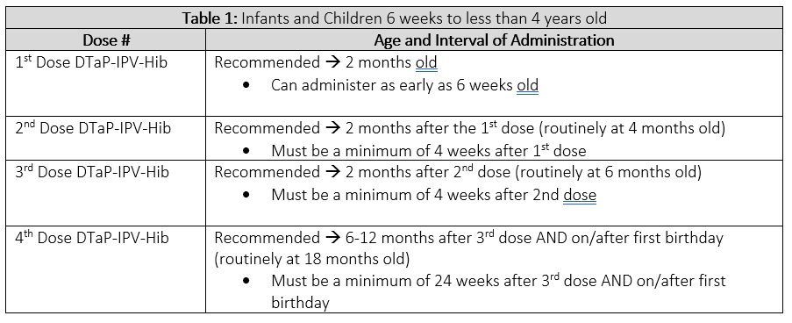
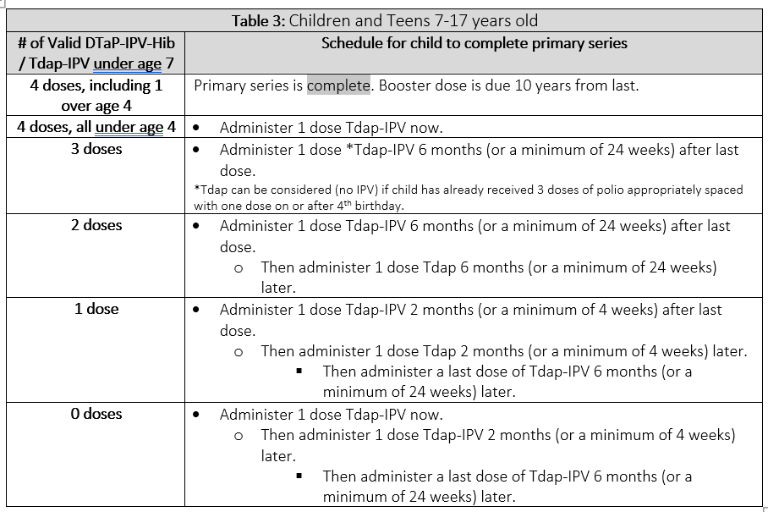
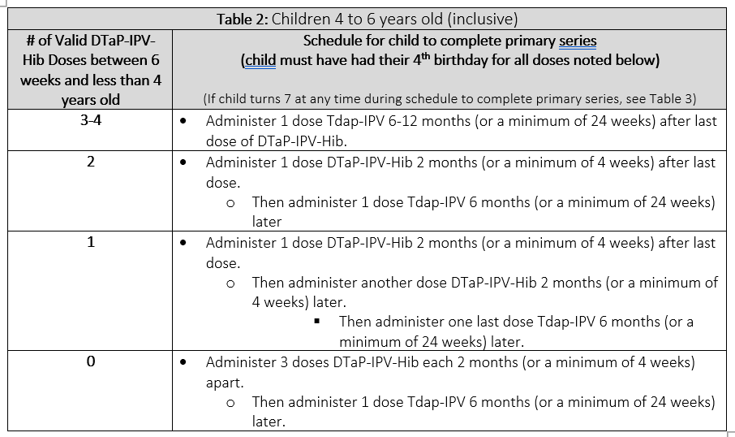
Refer to MLHU’s A Guide to Tetanus-Containing Combination Vaccines for more information about schedules and spacing

Slide 13
Measles, Mumps, Rubella and Varicella Vaccines
Antigen Code | Products Available | Antigen protection included in vaccine
MMR | MMRII PRIORIX | Measles (M), Mumps (Mu), and Rubella (R)
MMRV | ProQuad PRIORIX-TERTA | Measles (M), Mumps (Mu), Rubella (R), and Varicella (V or Var)
*Var | VARIVAX III VARILRIX | Varicella (Var) *required for patients born in 2010 and later
Age of Patient | Appropriate Vaccine
12 months to < 4 years old | MMR and Var (separate)
4 years to <13 years old | Either MMRV or MMR and Var separate
> 13 years old | MMR and Var (separate)
Notes:
There are three vaccines available when considering Measles, Mumps, Rubella and Varicella
MMR – MMRII or Priorix – Measles (M), Mumps (Mu), and Rubella (R)
MMRV – ProQuad or Priorix-Tetra - Measles (M), Mumps (Mu), Rubella (R), and Varicella (V)
Var – Varivax III or Varilrix – Varicella (Var)
Required for childcare and school for children in 2010 and
Product selection depends obviously on which antigens the patient requires protection for, but also their age.
For children 12 months to less than 4 years old – MMR and Varicella should be administered as separate vaccines (not as MMRV)
For children 4 years to less than 13 years old – MMRV can be given or MMR and Varicella separately depending on whether the child requires protection against varicella
For children 13 years or older - MMR and Varicella should be administered as separate vaccines (not as MMRV).
RULE #1: First dose MMR vaccine is due at 12 months and Varicella vaccine at 15 months old→ CANNOT be given before the patient’s first birthday.
Vaccines are considered invalid if given before the first birthday and must be repeated following minimum spacing
Discussion:
Some countries administer measles containing vaccine before age 1 and in Canada, MMR vaccine is approved for use infants as young as 6 months for reasons such as travel. However, to count towards childcare and school requirements, children under age 4 must have received a dose on or after their 1st birthday.
If the first dose of MMR vaccine is delayed beyond child’s first birthday, it may impact varicella being given at the recommended age of 15 months because of required spacing between live vaccines.
RULE #2: MMR and Varicella should be given as separate vaccines between 12 months and less than 4 years old.
Not considered invalid if given as MMRV and does not need to be repeated
Technically it isn’t publicly funded under the age of 4 years old
There is an increased risk of febrile seizures when administered between the ages of 12 and 23 months old
These vaccines can be given on the same day, for example if MMR is delayed and you want to give it at the 15 month appointment, and just need to be administered in separate arms

Slide 14
RULE #1: First dose MMR is due at 12 months and Varicella at 15 months old → CANNOT be given before the first birthday. Doses given before the first birthday do not count towards requirements and must be repeated following appropriate spacing.
RULE #2: MMR and Varicella should be given as separate vaccines between 12 months and < 4 years old. Not considered invalid if given as MMRV and does not need to be repeated.
RULE #3: Second doses of MMR and Varicella are due between 4 and 6 y.o. (before the 7th birthday).
RULE #4: MMR and Varicella can be administered as MMRV vaccine to children 4 to < 13 y.o. who require protection against all four antigens.
RULE #5: MMRV is NOT authorized for use in children > 13 y.o. → Must be given as separate vaccines. Vaccine is considered invalid and must be repeated as separate vaccines following appropriate spacing.
Notes:
RULE #1: First dose MMR vaccine is due at 12 months and Varicella vaccine at 15 months old→ CANNOT be given before the patient’s first birthday.
Doses given before the first birthday do not count towards requirements and must be repeated following appropriate spacing.
Discussion:
Some countries administer measles-containing vaccine before age 1 and in Canada, MMR vaccine is approved for use infants as young as 6 months for reasons such as travel. However, to count towards childcare and school requirements, children under age 4 must have received a dose on or after their 1st birthday.
If the first dose of MMR vaccine is delayed beyond a child’s first birthday, it may impact varicella being given at the recommended age of 15 months because of required spacing between live vaccines.
RULE #2: MMR and Varicella should be given as separate vaccines between 12 months and less than 4 years old.
Not considered invalid if given as MMRV and does not need to be repeated
Technically, MMRV it isn’t publicly funded under the age of 4 years old
There is an increased risk of febrile seizures when administered between the ages of 12 and 23 months old
These vaccines can be given on the same day, for example if MMR is delayed and you want to give it at the 15 month appointment, and just need to be administered in separate arms
RULE #3: Second doses of MMR and Varicella are due between the ages of 4 and 6 years old. To meet school requirements, it needs to be given before the patient’s 7th birthday
RULE #4: MMR and Varicella can be administered as MMRV to children 4 years to less than 13 years old who require protection against all four antigens.
RULE #5: MMRV is NOT authorized for use in children 13 years and older. MMR and Varicella must be given as separate vaccines
Vaccine is considered invalid and must be repeated as separate vaccines following appropriate spacing.

Slide 15
Order of Vaccines | Recommended / Minimum Interval
MMR then MMR | 4 weeks
MMR then MMRV / MMRV then MMR | 3 months / 6 weeks
MMR then Var / Var then MMR | 4 weeks
MMRV then MMRV | 3 months / 6 weeks
Var then MMRV / MMRV then Var | 3 months / 6 weeks
Var then Var | 3 months / 6 weeks

Slide 16
Meningococcal Vaccines
Antigen Code | Products Available | Neisseria meningitidis serogroup protection included in vaccine
Men-C-C | MENJUGATE Neisvac-C | Group C
Men-C-ACYW | Menactra MENVEO NIMENRIX | Groups A, C, Y, and W-135
RULE #1: Men-C-C is due when a child turns 1 y.o.→ CANNOT be given before the first birthday. Doses given before the first birthday do not count towards childcare and school requirements and must be repeated following 4 weeks minimum spacing. If Men-C-ACYW is given in error, dose counts and Men-C-C is not needed.
Notes:
There are two vaccines that are publicly funded under the routine vaccine program offering protection against meningococcal disease
Men-C-C – Menjugate or Neisvac-C – Group C
Men-C-ACYW – Menactra or Nimenrix (or Menveo which we haven’t used as part of the publicly funded program in quite some time) – Groups A, C, Y, and W-135
Men-B is publicly funded but only under the high risk program and it won’t be included in this presentation.
RULE #1: Men-C-C is due when a child turns 1 year old → cannot be administered before the first birthday.
Some provinces and other countries do administer Men-C-C before 12 months and it is actually authorized for use in this age. However in order to meet childcare and school requirements, the patient must receive a dose on or after their first birthday (no earlier). If a dose needs to be repeated because it was before 1 year old, 4 weeks minimum spacing is required.
If Men-C-ACYW was administered in error, the dose does count because it is also a conjugate vaccine and covers Group C of meningococcal disease. It is not routinely publicly funded at this age and depending on when it is given, may make them ineligible for a dose in grade 7
RULE #2: MMR and Varicella should be given as separate vaccines between 12 months and less than 4 years old.
Not considered invalid if given as MMRV and does not need to be repeated
Technically it isn’t publicly funded under the age of 4 years old
There is an increased risk of febrile seizures when administered between the ages of 12 and 23 months old
These vaccines can be given on the same day, for example if MMR is delayed and you want to give it at the 15 month appointment, and just need to be administered in separate arms

Slide 17
Meningococcal Vaccines
RULE #2: Men-C-ACYW is due when a child is in Grade 7. Dose is not publicly funded before September of the patient’s grade 7 year Patients have until they start Grade 8 to receive the vaccine to meet school requirements. If Men-C-C is given in error, Men-C-ACYW is still required following a 4 week minimum spacing. If Men-C-ACYW was given before Grade 7: Another dose is publicly funded if Men-C-ACYW was given < 5 y.o. Another dose is NOT publicly funded if Men-C-ACYW was given between 5 y.o. and start of Grade 7.
Notes:
There are two vaccines that are publicly funded under the routine vaccine program offering protection against meningococcal disease
Men-C-C – Menjugate or Neisvac-C – Group C
Men-C-ACYW – Menactra or Nimenrix (or Menveo which we haven’t used as part of the publicly funded program in quite some time) – Groups A, C, Y, and W-135
Men-B is publicly funded but only under the high risk program and it won’t be included in this presentation.
RULE #2: Men-C-ACYW is due when a patient is in grade 7
Dose is not publicly funded before September of the patient’s grade 7 year – this means patients should not be receiving it in the summer before they go into grade 7
Patients have until they start Grade 8 to receive the vaccine to meet school requirements
If Men-C-C was given in error, Men-C-ACYW is still required following a 4 week minimum spacing.
If Men-C-ACYW was given before grade 7 another dose is only publicly funded if it was administered between > 5 years old. If it was given between the ages of 5 years old and the start of grade 7, another dose is not publicly funded

Slide 18
Tools and Support
Publicly Funded Immunization Schedules for Ontario
MLHU Guide to…
Tetanus-Containing Vaccines
Measles, Mumps, Rubella and Varicella Vaccines
Meningococcal Vaccines
Consult a public health nurse on the Health Unit’s Vaccine Preventable Disease Team
Telephone: (519) 663-5317, press 4 for priority queue
Email: shots@mlhu.on.ca (omit patient identifying information)
Fax: (519) 663-0416

Slide 19
NOTICE OF eNEWSLETTER and WEBINAR FREQUENCY:
eNewsletters will continue twice a month through July and August.
Thank you for your engagement in our webinars!
Webinars will return in the fall.
Wishing you a safe and wonderful summer!

Slide 20
Questions?
Ask using chat function now, or after the webinar at: healthcareproviders@mlhu.on.ca
For urgent matters please call the Health Unit’s main line at 519-663-5317
For more information www.healthunit.com/healthcare-providers

