Slide 1
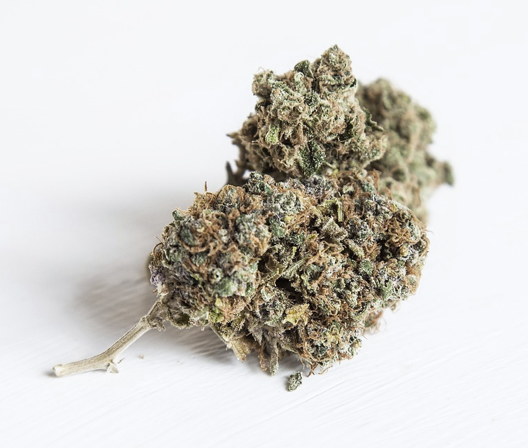
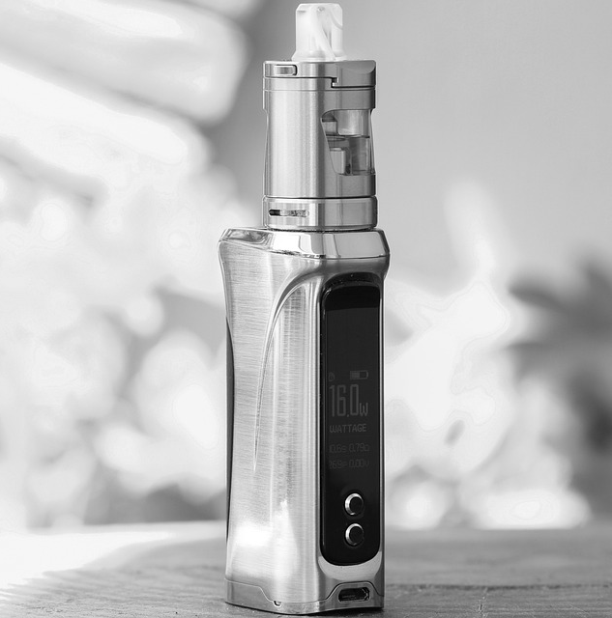
Before You Teach:​
A Comprehensive Approach to Substance Use Prevention in Schools​
Created May 2022
Revised February 2023
Notes:
https://pixabay.com/photos/weed-ganga-marijuana-cannabis-nug-2105966/
https://pixabay.com/photos/amber-glass-dropper-bottles-4131118/
https://pixabay.com/photos/vape-cigarette-electronic-smoke-5560995/

Slide 2
Presentation Outline
The Current Context​
Strategies that are NOT effective at preventing/reducing substance use​
Risk and Protective factors​
Guiding principles for teaching substance use prevention ​
Effective strategies for reducing substance use ​
Comprehensive School Health to Summarize Learning​
When you suspect substance use ​

Slide 3
The Current Context
Expanded access to substances:​
Since legalization of cannabis, the number of retail locations has exploded in the Thames Valley region with over 90 locations in place/in progress​
Access to alcohol has expanded to more retail locations​
Vaping supplies are visible and accessible: convenience stores, speciality stores and online retailers (poor enforcement of age requirements)​
2021 OSDUHS: more than 50% of students grade 7-12 noticed advertising for cannabis in the last month and more than a quarter of students interviewed had tried vaping
Notes:
Map used to search for Cannabis retailers: https://agco.maps.arcgis.com/apps/webappviewer/index.html?id=bef894bc0876448fba26333f1de8d370​
2021 OSDUHS: https://www.camh.ca/-/media/files/pdf---osduhs/2021-osduhs-report-pdf.pdf

Slide 4
Self-Reflection
Acknowledgement of sensitive subject: Everyone has had different experiences around substance use. For some, content being taught may be triggering. ​
Please take a moment to complete a self-reflection:​
How do I approach conversations on substance use?​
What biases am I holding when I approach this topic?​
How was substance use seen in my family?​
Are there additional experiences that have formed my approach to substance use?​
What is based on facts versus feelings?​
Recognize when biases are a factor in how you are hearing, learning and sharing information​
Notes:
Questions for reflection https://www.heretohelp.bc.ca/workbook/substance-use-and-young-people ​
What were your experiences with substances like when growing up? How did you feel about those experiences?​
How was substance use seen in your family, and how did you know?​
What other experiences do you think may have formed your approach to substance use?​
On a scale of 1-10 (with 1 being “Not at all” and 10 being “Extremely”), how comfortable are you with the idea of your kids trying and using various substances?​
Are there events in your family history that you think might impact your current attitudes about substances?​
How much of your understanding of substance use is based on facts vs. your feelings? (you can assign a percentage value to each to help you think about this)​
​
​
Ineffective Strategies​
Information dissemination programs which teach primarily about drugs and their effects;​
Fear arousal programs that emphasize risks associated with drug use;​
Moral appeal programs that teach about the evils of use and;​
Affective education programs which focus on building self-esteem, responsible decision-making, and interpersonal growth.​
https://www.publicsafety.gc.ca/cnt/rsrcs/pblctns/sclbsd-drgbs/index-en.aspx ​
​
​

Slide 5
Ineffective Strategies for Substance Use Prevention:
Just Say "NO"
Messaging regarding evils of substance use​
Naming substances and their effects​
Focus on risks and negative consequences of substances
Notes:
Ineffective Strategies​
Information dissemination programs which teach primarily about drugs and their effects;​
Fear arousal programs that emphasize risks associated with drug use;​
Moral appeal programs that teach about the evils of use and;​
Affective education programs which focus on building self-esteem, responsible decision-making, and interpersonal growth.​
https://www.publicsafety.gc.ca/cnt/rsrcs/pblctns/sclbsd-drgbs/index-en.aspx ​
​
​

Slide 6
Risk and Protective Factors
Risk Factors are the factors/conditions that make someone more susceptible to substance use and negative outcomes​
Protective Factors are the conditions or attributes that help mitigate risks and reduce the susceptibility to substance use​
Notes:
Risk Factors: Mental Health diagnosis, family history of addiction, peer group in word count of substance use​
Protective Factors: access to community supports, knowledge of coping skills, sense of belonging, active, fed and rested, having positive outlook/self-esteem, healthy relationships ​

Slide 7
Key Principles and Protective Factors
Parent Child Relationship​
School Connectedness ​
Harm Reduction​
Comprehensive School Health​

Slide 8
Key Principles and Protective Factors
Building positive parent/guardian child relationships:​
Involve parents with homework assignments to open communication between parents and students​
Classroom-based prevention efforts are complimented with strategies involving family, community and policy​
School Connectedness*:​
Protective effects of School engagement, connectedness to school and teachers (also positive impacts for student mental health)​
The social environment has impacts for social influence and normative education​
Notes:
*Note for School Connectedness: There is an additional toolkit for Schools on School Connectedness and this work is done using a Comprehensive School Health model​
Involving parents keeps communication open and normalizes that families can talk about substance use openly ​

Slide 9
Guiding Documents/Philosophies
Public Health Agency of Canada (2021). Blueprint for Action: Preventing substance-related harms among youth through a Comprehensive School Health approach​
Supports school community members in planning and implementing strategies for preventing substance-related harms among youth:​
Grounded in evidence (including practice-based evidence)​
Reflect students' diverse needs and environments​
Helps school communities to maximize supports for health and well-being​
This model identifies four evidence-based approaches to preventing substance-related harms:​
Upstream Prevention​
Harm Reduction​
Stigma Reduction​
Equity-oriented
Notes:
Link to document: https://www.canada.ca/en/public-health/services/publications/healthy-living/blueprint-for-action-preventing-substance-related-harms-youth-comprehensive-school-health/guide.html#s2-1​
​
The model approaches substance-use prevention from a lens consisting of the 4 pillars identified on the slide and integrating those pillars with the Comprehensive School Health framework. The Comprehensive School Health framework used in the Blueprint for Action document consists of 4 pillars as well: social and physical environments, policy, teaching and learning, and partnerships and services; this framework is slightly different than the Comprehensive School Health framework identified later in this presentation, but the two share many similarities and could be used as companions to one another. ​
​
Upstream prevention – building protective factors among students to avoid the negative impact of risk factors, such as poverty, social isolation, experiences of trauma, abuse, discrimination, etc. "The best prevention measures often have nothing to do with substance use at all".​
Harm reduction – efforts aiming to reduce potential social and health harms related to substance use. Individuals vary in their experience with substance use and with their openness to supports or change, because of this, harm reduction takes an inclusive and pragmatic approach to preventing substance-related harms among youth.​
Stigma reduction – efforts aiming to reduce negative stereotypes associated with substance use, which create separations such as "us vs them" mentalities. Efforts to reduce stigma can undo dehumanization that often comes with stigma by way of creating open and safe spaces, creating opportunities for non-judgmental information exchange, and enhancing socio-emotional skills like empathy and compassion.​
Promoting equity – creating opportunities for everyone to reach their full health potential, as certain populations are disproportionally impacted by substance use. These approaches seek to make systems more accessible, responsive, compassionate, and safer for all people. Examples of equity-based approaches includes ensuring cultural safety within systems, and approaching practice with a trauma and violence informed lens. ​
​
The document linked above provide tangible examples/suggestions for integrating these 4 pillars within school settings.​

Slide 10
Key Principles - Harm Reduction
Harm Reduction Strategies:​
Use of seatbelts while in a vehicle​
Wearing a helmet (e.g. biking, snowboarding, hockey, etc.)​
Use of condoms to prevent STI transmission​
Consuming water while drinking alcohol​
Using a nicotine patch instead of smoking​
Using substances in a safe environment with someone trusted​
Needle exchange programs​
Notes:
Thinking back to the Current Context and How it Informs How We Teach Substance Use​
- evidence informed concepts​
https://ontario.cmha.ca/harm-reduction/ ​
​
Applicable Harm Reduction Principles from harmreduction.org: ​
1) Recognize issue and aims to address harmful effects rather than ignore or condemn ​
2) Recognize realities of poverty, racism, social isolation, past trauma along with other factors contribute to vulnerability to substance-related harms ​
3) Acknowledges that there is a continuum of behaviours and that some ways of using are less harmful than others ​
4) Does not attempt to ignore the real harm and danger associated with substance use ​
​
https://harmreduction.org/about-us/principles-of-harm-reduction/ ​

Slide 11
Components of Harm Reduction
Pragmatism: Public health approach used to minimize potential harms understanding there will always be some substance use ​
Humane Values: Judgement is not placed on people who use substances​
Focus on Harms: the potential harms of the substance use are prioritized over the use itself​
Balancing of Costs and Benefits​
Priority of Immediate Goals​
From the Canadian Centre on Substance Abuse​
Notes:
Thinking back to the Current Context and How it Informs How We Teach Substance Use​
- evidence informed concepts​
https://www.ccsa.ca/harm-reduction-whats-name ​
https://ontario.cmha.ca/harm-reduction/ ​
https://harmreduction.org/about-us/principles-of-harm-reduction/ ​
​
Creating an inclusive environment: ​
Avoid stigmatizing and moralizing use ​
Acknowledge and integrate Indigenous/Decolonization Perspective while addressing content ​
Teach skills that set students up for success when approaching substances in their lives (Harm reduction through skill building) ​
Teaching while walking the fine line between harm-doing in knowledge sharing and actually sharing the knowledge so students understand potential effects of using substancees.​
​
Normative Social Influence Education: Behaviour is influenced by what people believe to be the 'norm' , conformity/compliance​
e.g. Instead of saying 15% of youth are using ____, there is a shift to 85% of youth are not using ____​
People sometimes change their behaviour, thoughts or values to fit in or be accepted​
Social Competence components: social skills, emotional self-regulation, interpersonal communication, cooperation, self-awareness, conflict resolution​
Social Influences: Looks at the social influences of substance use initiation​
(intentional or unintentional) efforts to change beliefs, attitudes, behaviours; individuals make these changes to fit into their societal context/environment​

Slide 12
Effective Strategies for Substance Use Prevention:
Engaging and interactive delivery techniques​
Multiple sessions over time​
Youth focused​
Social Competence and positive Social Influence​
Skills-based programs building decision-making skills, self-esteem and resistance to peer-pressure, social skills training​
Normative social influence education used to reinforce that most youth are not using substances​
Non-judgemental approach​
Notes:
Normative Social Influence Education: Behaviour is influenced by what people believe to be the 'norm' , conformity/compliance​
e.g. Instead of saying 15% of youth are using ____, there is a shift to 85% of youth are not using ____​
People sometimes change their behaviour, thoughts or values to fit in or be accepted​
Social Competence components: social skills, emotional self-regulation, interpersonal communication, cooperation, self-awareness, conflict resolution​
Social Influences: Looks at the social influences of substance use initiation​
(intentional or unintentional) efforts to change beliefs, attitudes, behaviours; individuals make these changes to fit into their societal context/environment

Slide 13
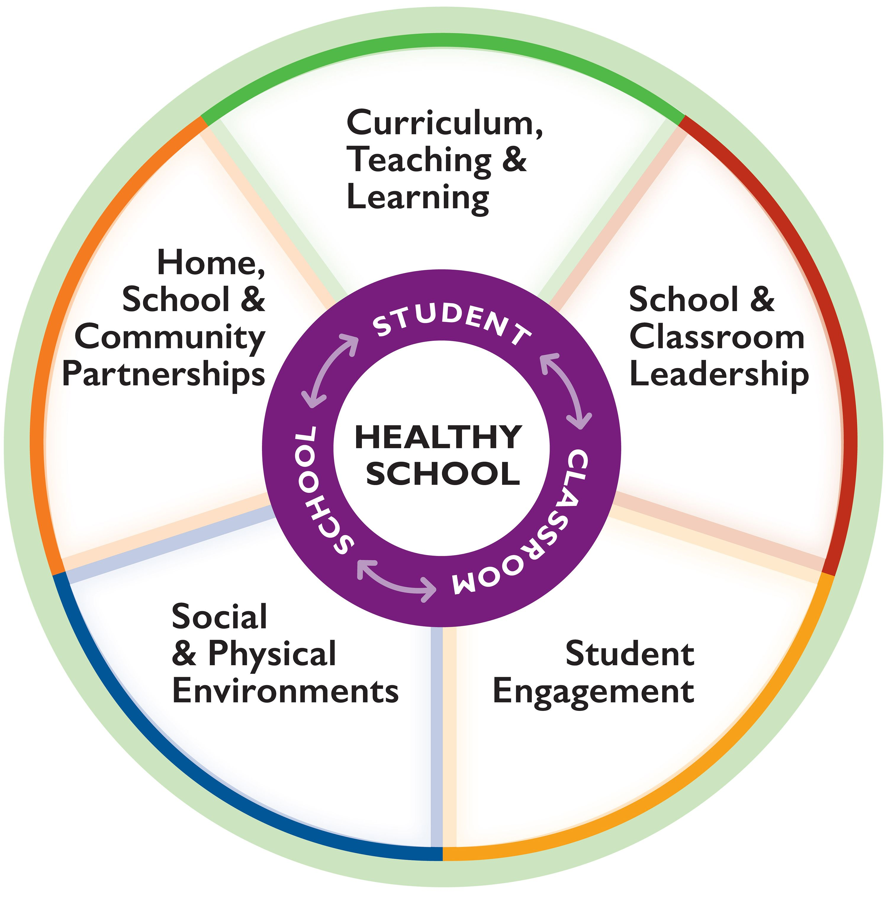
What Does a Comprehensive Approach for Preventing and Reducing Substance Use Look Like?
Classroom lessons, activities discussing mental health, substance use curriculum
Working with a community partner to plan an event, sending information home to parents to assist with parent-student communication regarding substance use
Professional learning opportunities regarding instructional strategies, students identify trends and where support is needed
Social: creates a culture of caring, lends to students having a sense of connectedness to their school
Physical: proper signage "no smoking or vaping within 20 meters of school property"
Protective factors: Student involvement in extra-curriculars, school-wide initiatives that promote connectedness and belonging
Notes:
Comprehensive School Health:
An internationally recognized approach supporting improvements in students’ educational outcomes while addressing school health in a planned, integrated, and holistic way beyond the classroom by incorporating health and wellbeing into all aspects of school and learning. This whole-school model builds capacity to incorporate well-being as an essential aspect of student achievement. Actions address inter-related components that comprise a comprehensive school health approach: • social and physical environment • curriculum, teaching and learning •School and classroom leadership • student engagement •social and physical environments (including healthy school policy) • partnerships and services. (JCHS; Foundations for a Healthy School)

Slide 14
When there are substance use concerns​
Approach:​
Non-judgemental and caring ​
Trusted adult ​
Communication: School, Student, Parent/Guardian​, School Nurse.
Familiarize yourself with school resources and processes prior to beginning Substance Use curriculum​
Use school referral system: connect with Social Worker or Student Support Counsellor​
Notes:
If there are concerns regarding vaping on school property, connect with your school PHN​

Slide 15
Additional resources to explore​
Dialogue in the Classroom
Drug Literacy Curriculum
​
Substance related harm prevention
Planet Youth Model/Icelandic Model​ (video)
Understanding Substance Use: Educator's Guide and Video Modules
Notes:
Dialogue in the Classroom
https://www.uvic.ca/research/centres/cisur/assets/docs/iminds/iminds-facilitating-dialog.pdf
Drug Literacy Curriculum
https://www.uvic.ca/research/centres/cisur/assets/docs/iminds/hs-pp-drug-curriculum.pdf ​
Substance related harm prevention
https://www.canada.ca/en/public-health/services/publications/healthy-living/blueprint-for-action-preventing-substance-related-harms-youth-comprehensive-school-health/guide.html#s3-1​
Planet Youth Model/Icelandic Model​ (video)
https://www.youtube.com/watch?v=1pxvHmB4ki4
Understanding Substance Use: Educator's Guide
https://ccsa.ca/understanding-substance-use-educators-guide?_cldee=RqDX9dvV70GWIsi07wOOBtaTp-fQiiDFM6V7-K9pF-GIn76V2ellQXaxdqhHbMCi&recipientid=contact-3907ede4f1d1e6118105480fcfeaa931-acc2dde29ea94dc1a413a086af927a0e&esid=70cc09b1-673e-ed11-bba3-0022486dc98c
https://ccsa.ca/educators-guide?_cldee=RqDX9dvV70GWIsi07wOOBtaTp-fQiiDFM6V7-K9pF-GIn76V2ellQXaxdqhHbMCi&recipientid=contact-3907ede4f1d1e6118105480fcfeaa931-acc2dde29ea94dc1a413a086af927a0e&esid=70cc09b1-673e-ed11-bba3-0022486dc98c

