Slide 1
Vaping and Nicotine Pouches
Created by: School Health Team
Created: September 2022
Updated: August 2024

Slide 2
Overview( Learning Goals)
E-cigarette devices and how they work
Nicotine and vape
Nicotine pouches
Health effects
Laws and fines
Harm reduction
Community supports

Slide 3
Activity: Power Words
Activity from Ontario Lung Association’s Talking About Vaping Series:
https://operationfresh.wpenginepowered.com/wp-content/uploads/2023/01/Talking_About_Vaping_V5nl.pdf
Notes:
1.1 Intro Activity– Power Words
From Ontario Lung Association’s Talking About Vaping Series:
https://operationfresh.wpenginepowered.com/wp-content/uploads/2023/01/Talking_About_Vaping_V5nl.pdf
Objective: To establish existing knowledge about vaping among youth.
TIME: 10 minutes
MATERIALS:
• Flip Chart Paper or White Board
• Markers
• Post-it Notes
• Pens
PREPARATION:
• Prepare a flipchart with the question “What Do We Know?”
INSTRUCTIONS:
• Hand out a post-it note to every participant and ask them to write down the first thing that comes to mind when they think about vaping (What do you already know about e-cigarettes and vaping?)
• Have participants post their notes on the flipchart/white board
• After everyone has posted their post-it notes, have participants gather around the flipchart to look at all of the responses
• Have the group reflect on the questions/responses
REFLECTION QUESTIONS:
• How hard/easy was it to answer the question?
• What patterns/trends do you see emerging when you look at everyone’s response?
Source:
The Ontario Lung Association. (2022). Talking about... Series. Retrieved from:
https://42wsqg1rthg11z8qhww68l41-wpengine.netdna-ssl.com/wp-content/uploads/2020/02/Talking_About_Vaping_V5nl.pdf
Image: Canva

Slide 4
E-Cigarette Basics
Known by a variety of names such as e-cigarettes, e-cigs, e-hookahs, vapes, vape pens, mods, tank systems
Can be called by their brand names such as Vuse, STLTH, Elf Bar, Smok, and Aspire.’
Notes:
4 main components of an e-cigarette:
battery
mouthpiece
heating element
Cartridge or chamber, such as a tank or reservoir to contain a liquid solution (E-Juice)
Source:
Health Canada. (2022). About Vaping. Retrieved from: https://www.canada.ca/en/health-canada/services/smoking-tobacco/vaping.html
Image: https://e-cigarettes.surgeongeneral.gov/getthefacts.html

Slide 5
The Mechanics
1. Vaping liquid, which contains chemicals, is heated to become an aerosol.
2. The aerosol is inhaled through the mouth and lungs where it is absorbed into the bloodstream.
3. The remaining aerosol is exhaled.
Notes:
Vaping is the act of inhaling and exhaling an aerosol produced by a vaping product.
Liquid (e-Juice) from inside the tank or reservoir is heated turning it into a vapour.
The vapour is then condensed into an aerosol which is inhaled by the user through the mouthpiece.
Does not require burning like a tobacco cigarette.
The Mechanics of Vaping video: www.canada.ca/en/health-canada/services/video/mechanics-vaping.html
Sources:
Health Canada. (2022). About Vaping. Retrieved from: https://www.canada.ca/en/health-canada/services/smoking-tobacco/vaping.html
Middlesex London Health Unit. (2020). Vapour Products (Electronic Cigarettes). Retrieved from: https://www.healthunit.com/e-cigarettes
Image: Health Canada. (2022). Talking with your Teen about Vaping – A Tip Sheet for Parents. Retrieved from: https://www.canada.ca/en/services/health/publications/healthy-living/talking-teen-vaping-tip-sheet-parents.html

Slide 6
What are Pods?
Vaping liquids typically contain a variety of chemicals including:
A carrier solvent (e.g. propylene glycol and vegetable glycerin)
Chemical flavourings
Nicotine
Although the solvent and flavourings may be safe to eat, the safety of inhaling these chemicals into the lungs remains unknown.
At high levels, these chemicals may be toxic and may cause irritation and damage to the lungs.
Notes:
Source:
Middlesex London Health Unit. (2020). Vapour Products (Electronic Cigarettes). Retrieved from: Vapour Products — Middlesex-London Health Unit

Slide 7
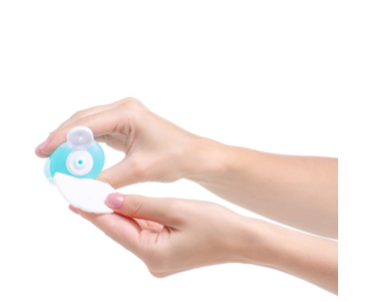
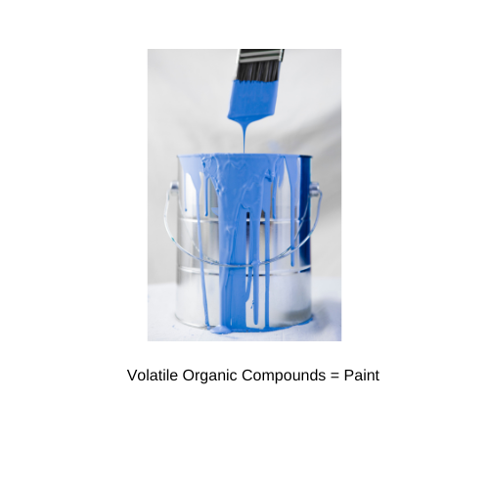
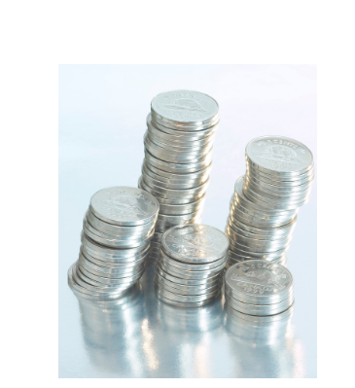
The chemicals in your pods are also in...
Paint = Volatile Organic Compounds
Paint Thinner = Benzene
Nail Polish Remover = Acetone
Fireworks = Rubidium
Coins = Heavy Metals
Embalming Fluids = Formaldehyde
Notes:
Vaping devices produce an aerosol that is made up of tiny particles, heavy metals (e.g. nickel, tin and lead), toxic substances (e.g. formaldehyde, cadmium and benzene), and nicotine.
The amount of potentially toxic substances a person can be exposed to from vaping or from exposure to second-hand vapour is affected by the type of the device and its settings, the battery power, the e-liquid components, the amount of nicotine, the frequency of vaping, and the amount of exposure to vapour. For example, using a vapour product with higher power and high temperature settings can produce more chemicals.
When added in the recommended amounts to food, propylene glycol, vegetable glycerin, and flavouring chemicals are generally considered safe to ingest. Although they may be safe to eat, the safety of inhaling these chemicals into the lungs remains unknown. At high levels, these chemicals may be toxic and may cause irritation and damage to the lungs.
Optional Video: Teardown video: www.youtube.com/watch?v=MfQ6pKVkkl4
Sources:
DownandDirtyVA. (2017). Teardown. Retrieved from: www.youtube.com/watch?v=MfQ6pKVkkl4
Middlesex London Health Unit. (2020). Vapour Products (Electronic Cigarettes). Retrieved from: https://www.healthunit.com/e-cigarettes
Standford Medicine Tobacco Prevention Toolkit. (2022). So What's Really in These E-Cigarettes/Vapes? Retrieved from: https://med.stanford.edu/tobaccopreventiontoolkit/ppt-pages/Whats_in_E-Cigarettes.html
Images:
Canva

Slide 8
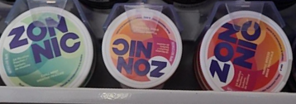
Nicotine Pouches
Notes:
Source:
https://www.healthunit.com/nicotine-pouches
https://recalls-rappels.canada.ca/en/alert-recall/unauthorized-nicotine-buccal-pouches-may-pose-serious-health-risks-0
Image : from TEO
Nicotine Pouches are
pre-portioned pouches with varying concentrations of nicotine, along with cellulose, water, flavouring, and sodium carbonate
placed in between the lip and gum of the mouth
highly addictive in any form and has adverse effects on youth and young adult brain development
Zonnic is the only brand approved by Health Canada to be sold in stores? There are dozens of prohibited brands we see in store everyday like Zyn, Fox, Velo, 77, Knlit.

Slide 9
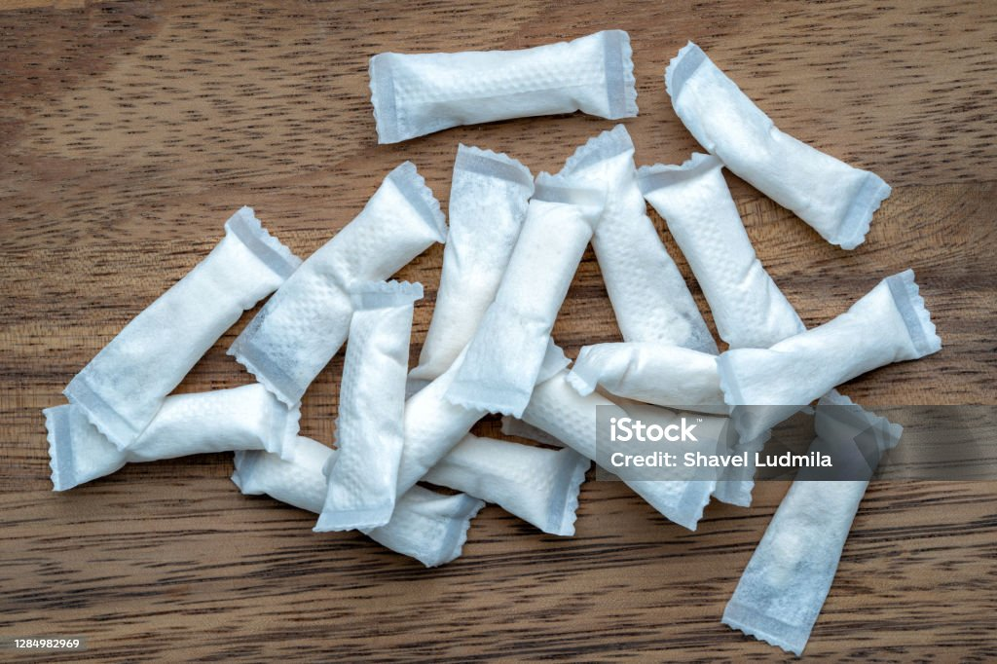
Nicotine Pouches
Notes:
Source
https://www.healthunit.com/nicotine-pouches
https://recalls-rappels.canada.ca/en/alert-recall/unauthorized-nicotine-buccal-pouches-may-pose-serious-health-risks-0
Image https://www.istockphoto.com/photo/box-of-swedish-nicotine-snus-on-wood-background-gm1284982969-381960013?utm_campaign=srp_photos_top&utm_content=https%3A%2F%2Funsplash.com%2Fs%2Fphotos%2Fnicotine-pouch&utm_medium=affiliate&utm_source=unsplash&utm_term=nicotine+pouch%3A%3A%3A
Nicotine Pouches
Put a person at risk of developing addiction to other substances later in life.
Excessive amounts of nicotine can lead to nicotine poisoning, which can cause severe headache, dizziness, vomiting, severe heartburn, cold sweats, blurred vision, mental confusion, and chest pain
Health Minister Mark Holland has issued an Order that will enact measures to reduce youth appeal and accessibility to nicotine pouches:
Prohibit advertising or promotion, including labelling and packaging, that could be appealing to youth.
Require NRTs in new and emerging formats, such as nicotine pouches, to be sold only by a pharmacist or an individual working under the supervision of a pharmacist, and to be kept behind the pharmacy counter.
Prohibit NRTs in new and emerging formats, such as nicotine pouches, from being sold with flavours other than mint or menthol.
Require a front of package nicotine addiction warning, as well as a clear indication of the intended use as a smoking cessation aid for adults trying to quit smoking.
Require manufacturers to submit mock-ups of labels and packages for all new or amended NRT licenses to ensure no youth appeal.
The measures are to take effect August 28th, 2024

Slide 10
Understanding Addiction
Notes:
Understanding Addiction as a Disease is a 3 min 40 second video that explains how and why the human body becomes addicted.
Video: https://www.youtube.com/watch?v=-w8n9UOiBxE
Images: Canva

Slide 11
More about Nicotine
Nicotine is highly addictive
Exposure to nicotine before the age of 25 causes:
Long lasting effects on learning, memory and concentration
Increased risk of experiencing mood disorders
Increased risk of nicotine dependence and addiction
Young people who vape are four times more likely to smoke cigarettes
Notes:
Nicotine is the highly addictive drug found in tobacco products, such as cigarettes, cigars and chewing tobacco. Although some vaping devices and e-liquids do not contain nicotine, most do and the nicotine content varies from device to device. In 2021 Federal Regulations were established for the amount of nicotine in vaping devices. These regulations establish a maximum nicotine concentration of 20 mg/mL for vaping products manufactured or imported for sale in Canada. The regulations also prohibit the packaging and sale of vaping products if the nicotine concentration displayed on the package exceeds 20 mg/mL.
Brain development continues throughout the teenage years, completing around the age of 25. Research has shown that exposure to nicotine before the age of 25 can “rewire” the brain and cause long lasting negative effects on attention, memory, concentration, and learning.
Evidence has also shown that exposure to nicotine before the age of 25 can decrease impulse control, increase the risk of experiencing mood disorders (such as depression and anxiety), and increase the risk of developing nicotine dependence and addiction.
There is strong evidence that young people who vape products with nicotine are at a higher risk of ever using and becoming addicted to other combustible tobacco products (e.g. cigarettes). A recent study found that young people who use e-cigarettes were 4 times more likely to smoke tobacco cigarettes.
Sources:
Health Canada. (2022). Vaping Product Regulations. Retrieved from: https://www.canada.ca/en/health-canada/services/smoking-tobacco/vaping/product-safety-regulation.html
Middlesex London Health Unit. (2020). Vapour Products (Electronic Cigarettes). Retrieved from: https://www.healthunit.com/e-cigarettes
Image: Canva

Slide 12
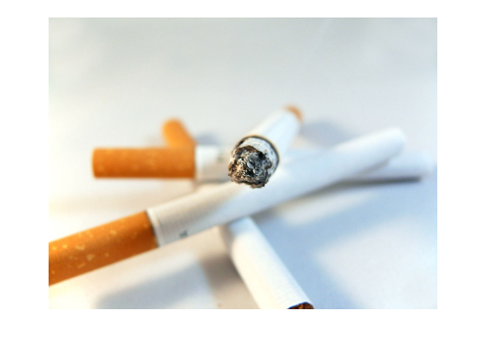
Types of Nicotine
Nicotine Salts
Combination of nicotine and acids
Allows users to experience a "smoother hit" which means larger amounts of nicotine can be inhaled with less irritation
This is harmful as it increases the risk of high nicotine consumption leading to addiction
Freebase Nicotine
Nicotine in its purest form
Used in traditional cigarettes and some vapes
Can cause throat irritation in large amounts
Notes:
The design of vapour products has evolved over the years with new devices that use cartridges or pods to deliver nicotine more efficiently, making them even more addictive. These pod devices use nicotine salts instead of a traditional e-liquid solution that contains freebase nicotine.
Vapour products using a nicotine salt solution deliver very high concentrations of nicotine to the user, providing a greater nicotine “hit” compared to traditional vapour product models.
For example, one 5% strength JUUL pod contains roughly the same amount of nicotine as one pack of cigarettes (20 cigarettes). Recent studies have shown that individuals using nicotine salt pod devices have similar amounts of nicotine in their blood compared to those who smoke cigarettes.
Sources:
Middlesex London Health Unit. (2020). Vapour Products (Electronic Cigarettes). Retrieved from: https://www.healthunit.com/e-cigarettes
Vitalite Health Network. (2019). Presentation on Vaping Prepared by Public Health Nurses. Retrieved from: https://www.vitalitenb.ca/sites/default/files/documents/soins/vitalite_vaping_notes_module-1.pdf
Image: Canva

Slide 13
1 milligram (mg) of Nicotine = 1 cigarette
Notes:
Key take away is that all pods contain high levels of nicotine! Remember the way that manufacturers are able to do this is through salt based nicotine making it easier to breathe in more nicotine with less irritation on the throat.
Source and Image:
Standford Medicine Tobacco Prevention Toolkit. (2022). E-Cigarette and Vape Pen Module. Retrieved from: https://med.stanford.edu/tobaccopreventiontoolkit/curriculum-decision-maker/by-module/E-Cigs.html

Slide 14
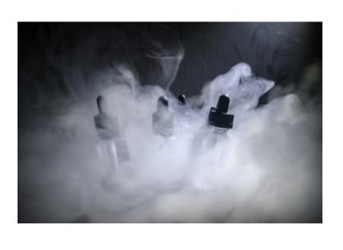
Water Vapour or Aerosols?
Vape pens allow the user to make large clouds
What is this cloud made of?
Notes:
There is much discussion about the end product of a vape. Many suggest it is harmless water vapour, however the cloud like substance that is exhaled after using a vape is considered an aerosol.
- What are some aerosols you can find around your house? (hair spray, whip cream can, spray paint, spray disinfectants)
- Water vapor is the steam you see above a boiling pot of water or a kettle.
"The ‘cloud’ is a mixture of many different chemicals that were either present in the e-liquid before or produced during the heating process" (Stanford University https://med.stanford.edu/tobaccopreventiontoolkit/ppt-pages/Whats_in_E-Cigarettes.html )
Source:
Standford Medicine Tobacco Prevention Toolkit. (2022). So What's Really in These E-Cigarettes/Vapes? Retrieved from: https://med.stanford.edu/tobaccopreventiontoolkit/ppt-pages/Whats_in_E-Cigarettes.html
Images: Canva

Slide 15
Water Vapour vs. Aerosols
Notes:
Source: Alaska Native Tribal Health Consortium. (2019). Vaping: Not Harmless Water Vapour. Retrieved from: https://youtu.be/jWY-As9PTWo

Slide 16
Why do Youth Vape?

Slide 17
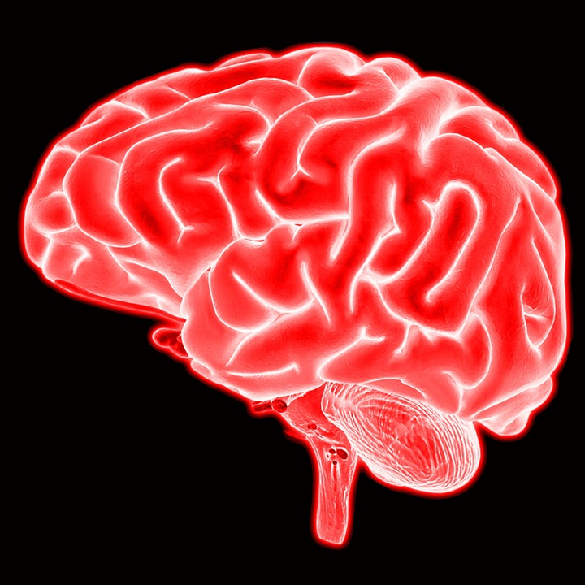
Reasons Youth Vape
Curiosity
Vaping Tricks
Stress
Head Rush or "Buzz"
Friends/Social
Flavours
Notes:
Ask the class, What are some reasons youth vape?
Source:
Health Canada. (2022). Preventing kids and teens from vaping. Retrieved from: https://www.canada.ca/en/health-canada/services/smoking-tobacco/preventing/vaping.html
Images:
Head Rush or "Buzz": https://pixabay.com/photos/brain-mind-neuroscience-cerebrum-6498036/
Vaping Tricks: https://pixabay.com/photos/heart-clouds-sky-blue-sky-love-1213475/
Stress: https://pixabay.com/photos/people-emotion-dramatic-female-1492052/
Flavours: https://pixabay.com/photos/caramel-candies-sweetmeats-sweet-1952996/
Friends/Social: https://pixabay.com/photos/pokemon-pokemongo-friends-school-1548194/
Curiosity: https://pixabay.com/illustrations/question-mark-a-notice-duplicate-2110767/

Slide 18
Health Effects of Vaping
Physical | Mental
Unintended Injuries Eye & Throat Irritation Heart & Lung Disease Tooth Decay Cancers Altered Fetal Development | Altered Teen Brain Development Mental Health Concerns: • Anxiety • Stress • Depression Altered Sleep: • Low Mood & Low Energy
Notes:
There are many health effects of vaping (physical and mental). See below for further information on each health effect.
Altered Teen Brain Development – When nicotine is used before the age of 25 it increases the risk of experiencing mood disorders and developing nicotine addiction.
Lung Disease – Vapour products expose users to harmful toxins and high levels of ultrafine particles that can be inhaled deeply into the lungs and may cause inflammation and increased mucus in the airways, as well as lung damage, and lung disease. Of particular concern are the recent reports of severe lung illness among people who use vapour products. Symptoms experienced include cough, shortness of breath, chest pain, nausea, vomiting, diarrhea, fatigue, fever, and weight loss
Heart Disease - Nicotine may cause an increased risk of developing heart disease among those who smoke tobacco products, and research suggests that people who vape may also be at a higher risk of developing heart disease. Vaping with nicotine has been shown to increase heart rate, and nicotine from vapour products may cause arteries and blood vessels to stiffen, potentially damaging these delicate tissues.
Cancers – The aerosol from vapour products contain chemicals that are suspected or known to cause cancer.
Altered Fetal Development - Nicotine is not safe for individuals to consume while pregnant, as nicotine is toxic to developing fetuses and can negatively influence brain development in utero.
Unintended Injuries - There is conclusive evidence that vapour products can explode and cause serious injuries and burns. This risk is significantly increased when batteries are of poor quality, stored improperly, or modified by the user.
Mental Health Concerns (anxiety, stress, depression) - vaping not only affects physical health but can also impact mental health. Young adults may use e-cigarettes as a way to cope not realizing the impact nicotine has on mental health. Mental health concerns can become worse through the use of e-cigarettes in the long term.
Altered Sleep - Nicotine also has an impact on sleep. Nicotine can stimulate the body causing it to awake and making it difficult to fall asleep and have a restful sleep. This can contribute to low mood; increased anxiety and reduced energy.
Sources:
Alaska Sleep Clinic. (2019). Vaping: New US Epidemic and Its Connection to Sleep. Retrieved from: https://www.alaskasleep.com/blog/vaping-new-us-epidemic-and-its-connection-to-sleep
Middlesex London Health Unit. (2020). Vapour Products (Electronic Cigarettes). Retrieved from: https://www.healthunit.com/e-cigarettes
Truth Initiative. (2021). Colliding Crises: Youth Mental Health and Nicotine Use. Retrieved from: https://truthinitiative.org/research-resources/emerging-tobacco-products/colliding-crises-youth-mental-health-and-nicotine-use

Slide 19
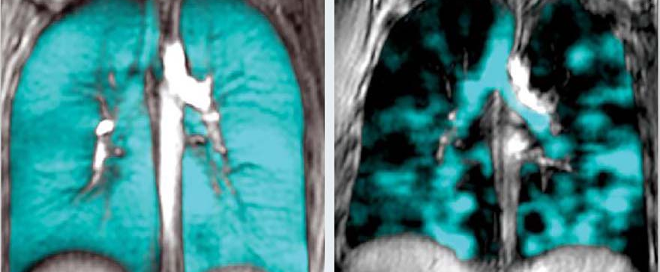
Vaping and Your Lungs
Western University researchers have used imaging technology to show the dire consequences of vaping on lungs.
The dark
regions show areas in the lungs that are blocked from inhaled air due to destroyed airways and tissue.
This is a healthy pair of lungs showing complete inhalation.
These are the lungs of a young person who vaped for a few months and became severely ill.
Notes:
Information from the research article:
A lung imaging scientist who focuses her research on finding a cure for asthma and COPD, she pivoted her team’s research to begin investigating exactly what was going on inside the lungs of vapers.
“From a societal point of view, vaping has been pitched to these young people as a safer alternative to cigarette smoking, but as the imaging shows, we can see that vaping is not safe,” said Parraga.
Using a specialized MRI method in her lab at Robarts Research Institute and using an inert gas that research participants inhale into their lungs, it is easy to see where the gas goes in the lungs, and more importantly, where it doesn’t go when it is blocked by destroyed airways and tissue.
“Our early results in vapers are driving our research in a new direction because we really want to understand what this means for children and teenagers over the long term,” she said. “Because our techniques are so sensitive, we are revealing abnormalities that can’t be detected using CT or pulmonary function tests.”
Parraga says the lungs are overengineered for everyday life - designed for intense exercise from the prehistoric days of hunting and avoiding predators. Because of this, symptoms don’t present during day-to-day activities until the damage is quite severe. She says because this same technology wasn’t around in the early days of smoking, they weren’t able to glean this kind of information about the damage until it was too late.
Image and research: https://www.schulich.uwo.ca/rapport/2020/robarts_discovery/grace_parraga.html#:~:text=%E2%80%9CWe%20are%20seeing%20a%20lot,now%20think%20we%20know%20why.%E2%80%9D

Slide 20
Smoking/Vaping and the Law
What is the law while you are in the school property?

Slide 21
Smoking/Vaping and the Law
Anyone found smoking or vaping on school property may be fined $305 for a first offence.
If you are caught selling or supplying vapour products (e-cigarettes or e-juice) to anyone under the age of 19 you could be fined $490 for each person you supplied to
Totaling a potential fine of $795!
Notes:
Tobacco Enforcement Officers with the Middlesex-London Health Unit enforce this law, monitoring all schools to ensure no one smokes in illegal areas.
School staff who witness an offence can report it to an Inspector who will lay a charge on the school’s behalf.
Subsequent offenders, with previous convictions, can get fines up to $5000.
Sources:
Ontario Court of Justice. (n.d.). Set Fines: Schedule 83.0.1: Smoke-Free Ontario Act, 2017. Retrieved from: http://www.ontariocourts.ca/ocj/how-do-i/set-fines/set-fines-i/schedule-83-0-1/
Middlesex London Health Unit. (2020). Vapour Products (Electronic Cigarettes). Retrieved from: https://www.healthunit.com/e-cigarettes

Slide 22
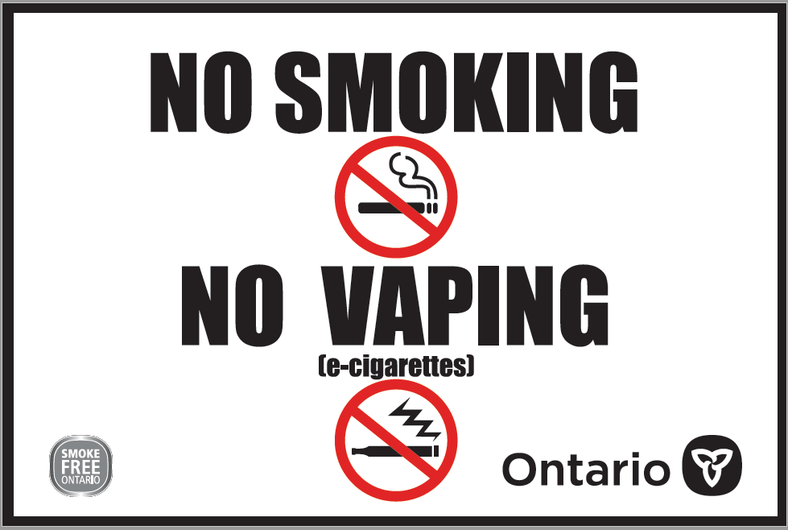
Smoke Free Ontario Act
Cannot sell or supply vapour products to anyone under 19 years of age (includes selling e-liquid)
Cannot use an e-cigarette to vape any substance where you cannot smoke tobacco
Public areas within 20m of the perimeter of school property, community/recreational facilities, sports fields, spectator areas
In a vehicle with anyone less than 16 years of age
Notes:
The Smoke-Free Ontario Act, 2017 regulates the sale, supply, use, display, and promotion of tobacco and vapour products, as well as the smoking and vaping of cannabis
* Please note, the above list is not a complete representation of the areas you can not vape under the SFOA, 2017.
Source:
Ministry of Health & Long-Term Care. (2018). Where you can't smoke or vape in Ontario. Retrieved from: https://www.ontario.ca/page/where-you-cant-smoke-or-vape-ontario
Image: https://www.ontario.ca/page/no-smoking-no-vaping-signs-businesses

Slide 23
Activity: Number, Cluster, Brainstorm
Activity from Ontario Lung Association’s Talking About Vaping Series:
https://operationfresh.wpenginepowered.com/wp-content/uploads/2023/01/Talking_About_Vaping_V5nl.pdf
Notes:
2.1 Intro Activity– Number Cluster Brainstorm
From Ontario Lung Association’s Talking About Vaping Series:
Talking About… VAPING / E-CIGARETTES (lunghealth.ca)
Time: 10 minutes
PREPARATION:
• Rearrange the room so there is enough space for participants to move around the room.
INSTRUCTIONS:
• Facilitator will call out a number between 2 and 5 while participants are moving around the room
• Participants will then have to quickly form groups based on the number that is called out (if there is an odd number, remaining participants can join the group closest to them)
• In their groups, participants must answer the question that the facilitator reads out:
1. Why do you think vaping has become so popular?
2. What are your biggest concerns about vaping?
REFLECTION:
Take some time to review the responses from each group
Source:
The Ontario Lung Association. (2022). Talking about... Series. Retrieved from:
https://42wsqg1rthg11z8qhww68l41-wpengine.netdna-ssl.com/wp-content/uploads/2020/02/Talking_About_Vaping_V5nl.pdf
Image: Canva

Slide 24
What is Harm Reduction?

Slide 25
Harm Reduction
An approach that seeks to reduce the health and social harms related to substance use
If an individual chooses to vape, the following tips will help reduce the risk:
Do not modify a device or add substances not intended by the manufacturer (THC oil/cannabis)
Do not purchase black market e-liquids, pods or devices
Avoid flavours known to cause harm (cinnamon, cherry, menthol, and products containing diacetyl)
Try using a product with lower nicotine content
Notes:
Sources:
Middlesex London Health Unit. (2020). Vapour Products (Electronic Cigarettes). Retrieved from: https://www.healthunit.com/e-cigarettes
Canadian Mental Health Association. (2022). Harm Reduction. Retrieved from: https://ontario.cmha.ca/harm-reduction/
Wellington Dufferin Guelph Public Health. (2023). Vaping Information Session for Parents with Dr. Tenenbaum. Retrieved from: https://wdgpublichealth.ca/your-health/vaping

Slide 26
Harm Reduction
Seek immediate medical attention for coughing, shortness of breath, or chest pain
Avoid sharing devices with other people (germs!)
Follow manufacturer's directions for storage, maintenance and cleaning
Use batteries compatible with the vapour product and store them safely
Store e-liquids/pods in a safe place away from children
Know where your school's boundaries are (20m from school property) - do not vape at school
Notes:
Source:
Middlesex London Health Unit. (2020). Vapour Products (Electronic Cigarettes). Retrieved from: https://www.healthunit.com/e-cigarettes

Slide 27
Where can I get help to quit smoking/vaping?

Slide 28
Community Supports
Need support quitting or cutting back?
Talk to your school's public health nurse or your family doctor/nurse practitioner
Quash App
free interactive smoking/vaping cessation program for youth
Smokers’ Helpline: online quit program
Text message support (text “iQuit” to 123456)
Notes:
Optional video: Quash- How it works Video: https://www.quashapp.com/how-it-works
Quash APP: https://www.quashapp.com/
Smokers Helpline: https://www.smokershelpline.ca/
Image: Canva

Slide 29
E-Cigarette & Vaping Kahoot
Notes:
Optional activity to supplement the presentation. You may need to create a Kahoot account if you do not already have one or can try to continue as a guest.
Link to E-Cigarette & Vaping Kahoot – (or search yatteamkahoot):
https://play.kahoot.it/v2/?quizId=c6bc2f17-2272-423c-b291-ee769dcd6856

