Slide 1
Healthcare Provider Outreach
Webinar
November 19, 2024

Slide 2
Welcome
Presenter:
Dr. Joanne Kearon
Associate Medical Officer of Health
Middlesex-London Health Unit
November 19, 2024

Slide 3
Outline
Respiratory Surveillance Report
Vaccine Updates
COVID-19 Reminders
Beyfortus / Nirsevimab RSV Product for Infants
Influenza Vaccine
Syphilis
Congenital Syphilis
Mycoplasma Pneumoniae - Increased Activity in Ontario
Public Health Ordering System (PHOS)
eNewsletter and Webinars
Questions

Slide 4
Respiratory Surveillance Report

Slide 5
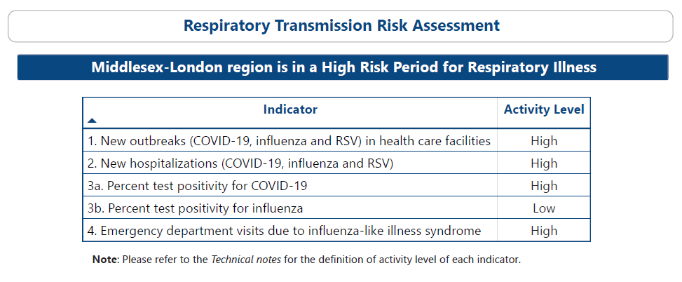
Data source: Middlesex-London Health Unit – Middlesex-London Respiratory Surveillance Report, extracted 2024-11-19. Data current as of the end of day 2024-11-19 . https://app.powerbi.com/view?r=eyJrIjoiODg3ZDIwOTctNzFmOS00MDczLWEwMDAtMDU1ZDk4OGZlMzgzIiwidCI6ImRjNTYxMjk1LTdjYTktNDFhOS04M2JmLTUwODM0ZDZhOWQwZiJ9

Slide 6
COVID-19
Data source: Middlesex-London Health Unit – Middlesex-London Respiratory Surveillance Report, extracted 2024-11-19. Data current as of the end of day 2024 11-19. https://app.powerbi.com/view?r=eyJrIjoiODg3ZDIwOTctNzFmOS00MDczLWEwMDAtMDU1ZDk4OGZlMzgzIiwidCI6ImRjNTYxMjk1LTdjYTktNDFhOS04M2JmLTUwODM0ZDZhOWQwZiJ9

Slide 7
Influenza
Data source: Middlesex-London Health Unit – Middlesex-London Respiratory Surveillance Report, extracted 2024-11-19. Data current as of the end of day 2024 11-19. https://app.powerbi.com/view?r=eyJrIjoiODg3ZDIwOTctNzFmOS00MDczLWEwMDAtMDU1ZDk4OGZlMzgzIiwidCI6ImRjNTYxMjk1LTdjYTktNDFhOS04M2JmLTUwODM0ZDZhOWQwZiJ9

Slide 8
Other Respiratory Viruses
Data source: Middlesex-London Health Unit – Middlesex-London Respiratory Surveillance Report, extracted 2024-11-19. Data current as of the end of day 2024-11-19. ​
https://app.powerbi.com/view?r=eyJrIjoiODg3ZDIwOTctNzFmOS00MDczLWEwMDAtMDU1ZDk4OGZlMzgzIiwidCI6ImRjNTYxMjk1LTdjYTktNDFhOS04M2JmLTUwODM0ZDZhOWQwZiJ9

Slide 9
Vaccine Updates

Slide 10
COVID-19 Vaccine Reminders
You can co-administer any other vaccine on the same day as the COVID-19 vaccine.
There is no pediatric Pfizer product this year.
Individuals 11 years of age and younger need to receive Moderna, which is from the same vial as adults (0.25ml for 6 months to 11 years and 0.5ml for 12 years and older).
When drawing up doses, a new needle tip should be used each time.
A needle tip should not be left in the stopper on an ongoing basis.
Punctured vials must be wasted when doses are not withdrawn and administered within the acceptable time.

Slide 11
COVID-19 Vaccine Reminders
The use of COVaxON is a requirement. All doses must be documented in the system within 24 hours of vaccine administration and prior to your Tuesday hand count survey.
Hand count surveys are mandatory, as all COVID-19 vaccine inventory must be balanced and reported to the Ministry by the health unit. Vaccine orders may be held if weekly surveys are not completed or reconciled.
Please reach out to COVIDVaccine.Informatics@mlhu.on.ca if you require assistance or support.

Slide 12
Beyfortus / Nirsevimab RSV Product for Infants
Stock is being replenished.
If your office placed an order and received a limited quantity, please order again.
50mg dose for infants under 5 kg
100mg dose for infants and children > 5 kg who qualify
For more information on eligibility and dosing:
October 16, 2024, HCP eNewsletter
Ministry of Health Infant RSV Guidance for Health Care Providers – Beyfortus

Slide 13
Influenza Vaccine
High dose Influenza Vaccine - Individuals 65 years of Age and Older
This product is still available to order.
MLHU thanks everyone for ordering and administering vaccines to help protect our community.

Slide 14
Syphilis

Slide 15
Syphilis
Between 2013 and 2022, there were 779 syphilis (all types) infections reported among Middlesex-London residents.
Most of the syphilis cases were considered infectious syphilis (76%, n=592).
The rate of syphilis (all types) and infectious syphilis both increased six-fold during that time, from 6 to 33 reported cases per 100,000 population for syphilis (all types) and from 4 to 23 per 100,000 for infectious syphilis.

Slide 16
Syphilis
Given the rising syphilis rates and the challenge with case detection, it is critical to maintain a high index of suspicion across all demographics.
You are encouraged to screen for syphilis as part of routine medical care for sexually active individuals.
The MLHU Syphilis web page includes all the resources for testing and treatment.

Slide 17
Congenital Syphilis
The number of cases of congenital syphilis has been rising sharply in recent years.
A Public Health Ontario surveillance report states that “between 2013 and 2018, a total of six cases of early congenital syphilis were reported provincially (i.e., an average of one case per year) however,
from 2019 to 2022 a total of 41 cases were reported.”

Slide 18
Congenital Syphilis
As healthcare providers, we need to continue to:
Normalize sexual health conversations with patients
Screen for syphilis -
In pregnancy, universal screening is recommended in the first trimester or at the first prenatal visit
Repeat screening at 28-32 weeks and again at delivery for pregnant women at ongoing risk of infection or reinfection, and in areas experiencing outbreaks
Consider screening pregnant individuals more frequently who are at ongoing risk of infection
All individuals who deliver a stillborn infant after 20 weeks of gestation.

Slide 19
Mycoplasma Pneumoniae - Increased Activity in Ontario

Slide 20
Mycoplasma Pneumoniae - Increased Activity in Ontario
Public Health Ontario shared the following information regarding an observed increase in Mycoplasma (M.) pneumoniae.
M. pneumoniae tends to occur in late summer and early fall and there are cyclical increases every 3 – 7 years.
Ontario is experiencing a marked increase in disease activity this year.
Total specimens tested, total positive specimens, and percent positivity are all increased compared to the same period last year.
Activity has remained high since August.

Slide 21
Mycoplasma Pneumoniae - Increased Activity
Based on preliminary data from PHO:
Disease activity is highest in children and adolescents.
Activity is highest in those aged 10 – 19 years, then 5 – 9 years, followed by 1 – 4 years.
This is notable because historically those under 4 years of age have very low disease activity.
This information should be interpreted in the context of potential testing bias, where some age groups may have been and continue to be tested at different frequency than others.

Slide 22
Mycoplasma Pneumoniae - Increased Activity
Reminder:
Mycoplasma pneumoniae is not a designated Disease of Public Health Significance and is not subject to mandatory reporting.
The MLHU will not conduct case and contact management for cases of Mycoplasma pneumoniae.

Slide 23
Mycoplasma Pneumoniae - Increased Activity
Testing/Laboratory Information
M. pneumoniae testing is conducted by PHO and many community and hospital laboratories in the province.
Information on PHO testing here: Mycoplasma pneumoniae – Respiratory PCR | Public Health Ontario.
Laboratory testing protocols, including testing criteria and the type and number of specimens, may differ between PHO laboratories and other community or hospital laboratories.

Slide 24
Mycoplasma Pneumoniae - Increased Activity
Clinical Practice Considerations:
HCPs should be aware of increasing M. pneumoniae activity in Ontario, including infections in young and school aged children, and be familiar with how to test for M. pneumoniae.
HCPs could consider M. pneumoniae infection among patients with community-acquired pneumonia who are not clinically improving on antibiotics that are known to be ineffective against M. pneumoniae, such as beta-lactams.
Since PHO has identified molecular markers that are associated with macrolide resistance in a subset of samples tested, consider using a second-line antibiotic regimen to treat patients with suspected or confirmed M. pneumoniae infection who aren't improving on macrolides.

Slide 25
Public Health Ordering System (PHOS) for Resources

Slide 26
Public Health Ordering System (PHOS) for Resources
The MLHU Resource Binder is now online – Sign up today!
PHOS is a one-stop online platform for Healthcare Providers in Middlesex County and the City of London to access and order publicly funded vaccines, and now, public health resources.
Those who order vaccines from MLHU will already be familiar with this platform.

Slide 27
Public Health Ordering System (PHOS) for Resources
Step by Step Instructions on how to get started are included in both the November 5th and November 19th eNewsletter.
PHOS provides the familiarity of the previous resource binder, while introducing new features designed to increase the ease of resource access and ordering.

Slide 28
eNewsletters and Webinars

Slide 29
eNewsletters and Webinars
The next newsletter is scheduled for December 3, 2024.
Join us on December 3, 2024, an exclusive webinar on how to use the Public Health Ordering System for ordering resources starts at 12:15 p.m.
If you have a suggestion for an email update, please share your ideas with us!​
We appreciate hearing from you.
You can contact us @ healthcareproviders@mlhu.on.ca

Slide 30
Thank you for joining us! Questions?
Ask using chat function now, or after the webinar at: healthcareproviders@mlhu.on.ca​
​For urgent matters please call the Health Unit’s main line at 519-663-5317​
​For more information www.healthunit.com/healthcare-providers

